Slide 1
Capstone Project Review-4
Smart Tourist Safety Monitoring & Incident Response System
using Al ,Geo-Fencing, and Blockchain-based Digital ID
Batch Number: CSE_34
Under the Supervision of,
Ms. Saiqa Khan N
Professor / Associate Professor / Assistant Professor School of Computer Science and Engineering Presidency University
Name of the Program: B.Tech(Computer Science And Engineering)
Name of the HoD: Dr. Asif Mohammed
Name of the Program Project Coordinator: Dr. Jayavadivel Ravi
Name of the School Project Coordinators: Dr. Sampath A K , Dr. Geetha A
Roll Number | Student Name
N SAI SANDEEP REDDY | 20221CSE0277
SOHAN K | 20221CSE0418
HARSHITH K R | 20221CSE0203

Slide 2
Problem Statement Number:
Organization:PRESIDENCY UNIVERSITY
Category (Hardware / Software / Both) : Software
Problem Description:
With the increasing adoption of smart city and digital tourism initiatives, there is a growing need for an intelligent, automated, and secure tourist safety solution. By integrating Artificial Intelligence (AI) for risk analysis, Geo-Fencing for location-based monitoring, and Blockchain-based Digital Identity for secure identification, the system can proactively monitor tourist safety and enable rapid incident response. This approach enhances tourist protection, builds trust in tourism services, and supports safer travel experiences.
Current systems do not provide real-time monitoring of tourist movement or timely detection of emergencies. The lack of an integrated platform and secure digital identity system causes delays in incident response and tourist verification.

Slide 3
Abstract :
Tourist safety has become a critical concern due to increasing incidents such as theft, harassment, medical emergencies, and loss of tourists in unfamiliar locations.
This project proposes a Smart Tourist Safety Monitoring & Incident Response System that integrates Artificial Intelligence (AI), Geo-Fencing, and Blockchain-based Digital ID to enhance tourist safety.
The system continuously monitors tourist movement using geo-fencing, detects abnormal or risky situations using AI-based analytics, and enables rapid incident reporting and response.
Blockchain ensures secure, tamper-proof digital identity management for tourists, improving trust and data integrity.
The proposed solution aims to provide real-time alerts, faster emergency response, and improved coordination among tourists, authorities, and service providers.

Slide 4
Literature Survey :
A detailed literature survey was conducted to understand existing research related to tourist safety systems, AI-based monitoring, geo-fencing technologies, and blockchain-based digital identity management. The review highlights current approaches, contributions, and limitations, which helped in identifying the research gap addressed by the proposed system.

Slide 5
Literature Survey :
Key Observations from the literature include :
AI techniques are widely used for anomaly detection and risk prediction, but many systems lack real-time deployment.
Geo-fencing has proven effective in location-based alerts; however, it is often limited to basic boundary violation detection.
Blockchain-based digital identity systems enhance security and privacy, but their integration with safety monitoring applications remains limited.
Existing tourist safety applications rely heavily on manual reporting and centralized databases, making them vulnerable to data tampering and delayed response.

Slide 6
Literature Survey :
Research Gap:
Very few studies integrate AI + Geo-Fencing + Blockchain into a single, unified tourist safety framework with real-time incident response and secure identity verification.

Slide 7
Objectives :
The main objectives of the proposed system are:
To monitor tourist movement in real time using geo-fencing techniques.
To detect abnormal or unsafe situations using AI-based analysis.
To provide instant alerts and emergency notifications to authorities and emergency contacts.
To implement a secure, blockchain-based digital identity system for tourists.
To ensure data integrity, privacy, and trust in tourist safety records.
To reduce emergency response time during critical incidents.

Slide 8
Existing Methods and Drawbacks :
Existing Methods :
Mobile safety apps with SOS buttons.
GPS-based tracking systems.
Centralized tourist databases.
Manual incident reporting mechanisms.
Drawbacks :
Lack of real-time intelligent threat detection
Heavy dependency on user-initiated alerts.
Centralized databases prone to data tampering and single-point failure
No secure and verifiable tourist identity management.
Delayed response from authorities due to poor system integration.

Slide 9
Proposed Method & Feasibility Study :
Proposed Method:
The proposed system combines :
AI modules to analyze movement patterns and detect anomalies.
Geo-Fencing to define safe and restricted zones for tourists.
Blockchain-based Digital ID to store verified tourist identity details securely.
Automated alert system for real-time incident reporting to authorities.
Feasibility Study:
Technical Feasibility: Uses existing technologies such as GPS, AI models, and blockchain platforms.
Economic Feasibility: Minimal hardware requirements; mainly software-based implementation.
Operational Feasibility: Easy to use for tourists and authorities through mobile and web interfaces.

Slide 10
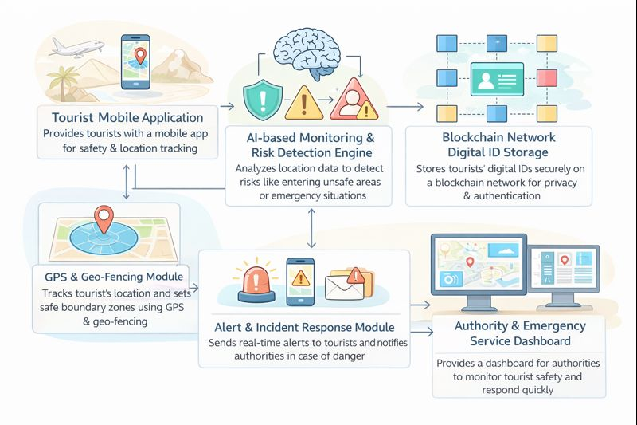
Architecture Diagram :

Slide 11
Modules :
Tourist Registration Module – Blockchain-based digital ID creation
Location Tracking Module – Real-time GPS tracking and geo-fencing.
AI Risk Detection Module – Detects abnormal patterns and threats
Incident Reporting Module – Automatic and manual incident alerts.
Blockchain Security Module – Ensures data integrity and authentication.
Authority Response Module – Dashboard for police and emergency teams.

Slide 12
Hardware and Software Details :
Database: MySQL / MongoDB
Hardware :
Smartphone with GPS
Server / Cloud Infrastructure
Software:
Programming Language: Python / Java
Frontend: Android / Web Application
Backend: Flask / Spring Boot
Blockchain Platform: Ethereum / Hyperledger
Tools: VS Code, Android Studio

Slide 13
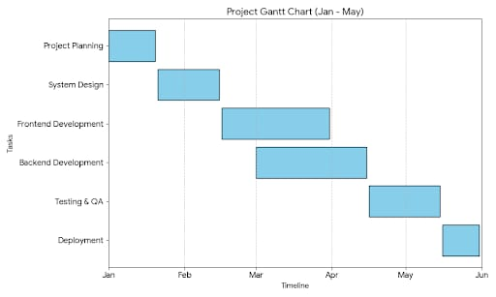
Timeline of the Project (Gantt Chart)

Slide 14
Github Link
https://github.com/Nelakurthi-Sai-Sandeep-reddy/Smart-Tourist-Safety-Monitoring-Incident-Response-System-using-Al-Geo-Fencing-and-Blockchain

Slide 15
References (IEEE Paper format)
[1]. Chaudhuri, R., Chatterjee, S., & Vrontis, D. (2024). Blockchain technology for protecting and validating transactions in the travel and tourism sector. Revista de Gestão, Emerald Publishing. [Focus: Fraud reduction and data privacy].
[2]. Wörndl, W., & Herzog, D. (2020):Smart tourism service systems based on IoT and machine learning for optimized resource utilization. Journal of Intelligent & Fuzzy Systems. [Focus: Safety monitoring in rural areas].
[3].Gear Smiths Team (2025). SIH2K25: Smart Tourist Safety Monitoring and Incident Response System. Ministry of Tourism & Home Affairs Presentation. [Focus: Real-time location tracking and admin dashboards].

Slide 16
References (IEEE Paper format)
[4]. D. S. Gamage and D. I. De Silva, “Blockchain–AI–Geolocation Integrated Architecture for Mobile Identity and Verification,” Future Internet, vol. 17, no. 12, pp. 1–18, 2025.
[5]. A. Kontogianni, E. Alepis, M. Virvou, and C. Patsakis, Smart Tourism: The Impact of Artificial Intelligence and Blockchain. Cham, Switzerland: Springer Nature, 2024.
[6]. “Geo-Fencing Technology to Establish Safety Zones,” Journal of Emerging Technologies and Innovative Research (JETIR), vol. 12, no. 3, pp. 1–6, Mar. 2025.
[7]“Advancements in Digital Safety Technologies for Tourism,” International Journal of Research and Innovation in Social Science (IJRISS), vol. 9, no. 14, pp. 1235–1262, 2025.

Slide 17
References (IEEE Paper format)
[8]. R. Islam, R. Bose, S. Roy, et al., “A Decentralized Trust Framework for Smart Cities,” Scientific Reports, vol. 15, no. 1, pp. 1–12, 2025.
[9]. L. Peng and Y. Chen, “Tourism safety monitoring information service system based on Internet of Things and block-chain,” Journal of Intelligent & Fuzzy Systems, June 2021.
[10]. U. Salunkhe, C. Kumar, and S. J. Khare, “Block Chain Intervention in the Tourism Industry: A Systematic Review,” Academy of Marketing Studies Journal, vol. 28, no. 2, pp. 1–9, 2024.

Slide 18


